Slide 1

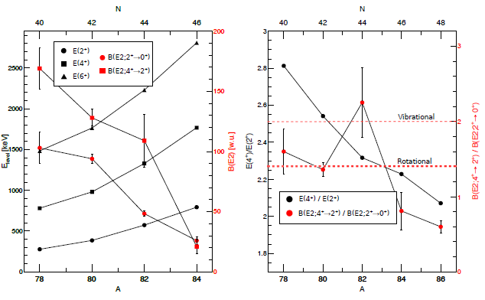
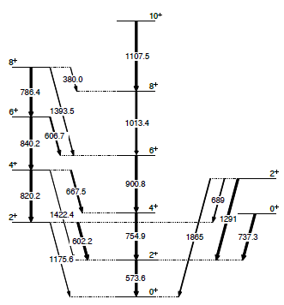
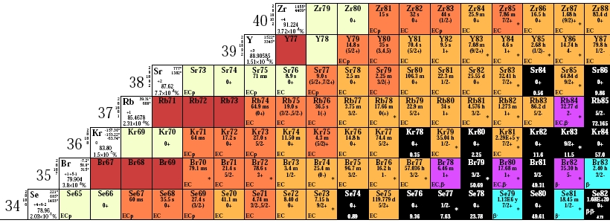
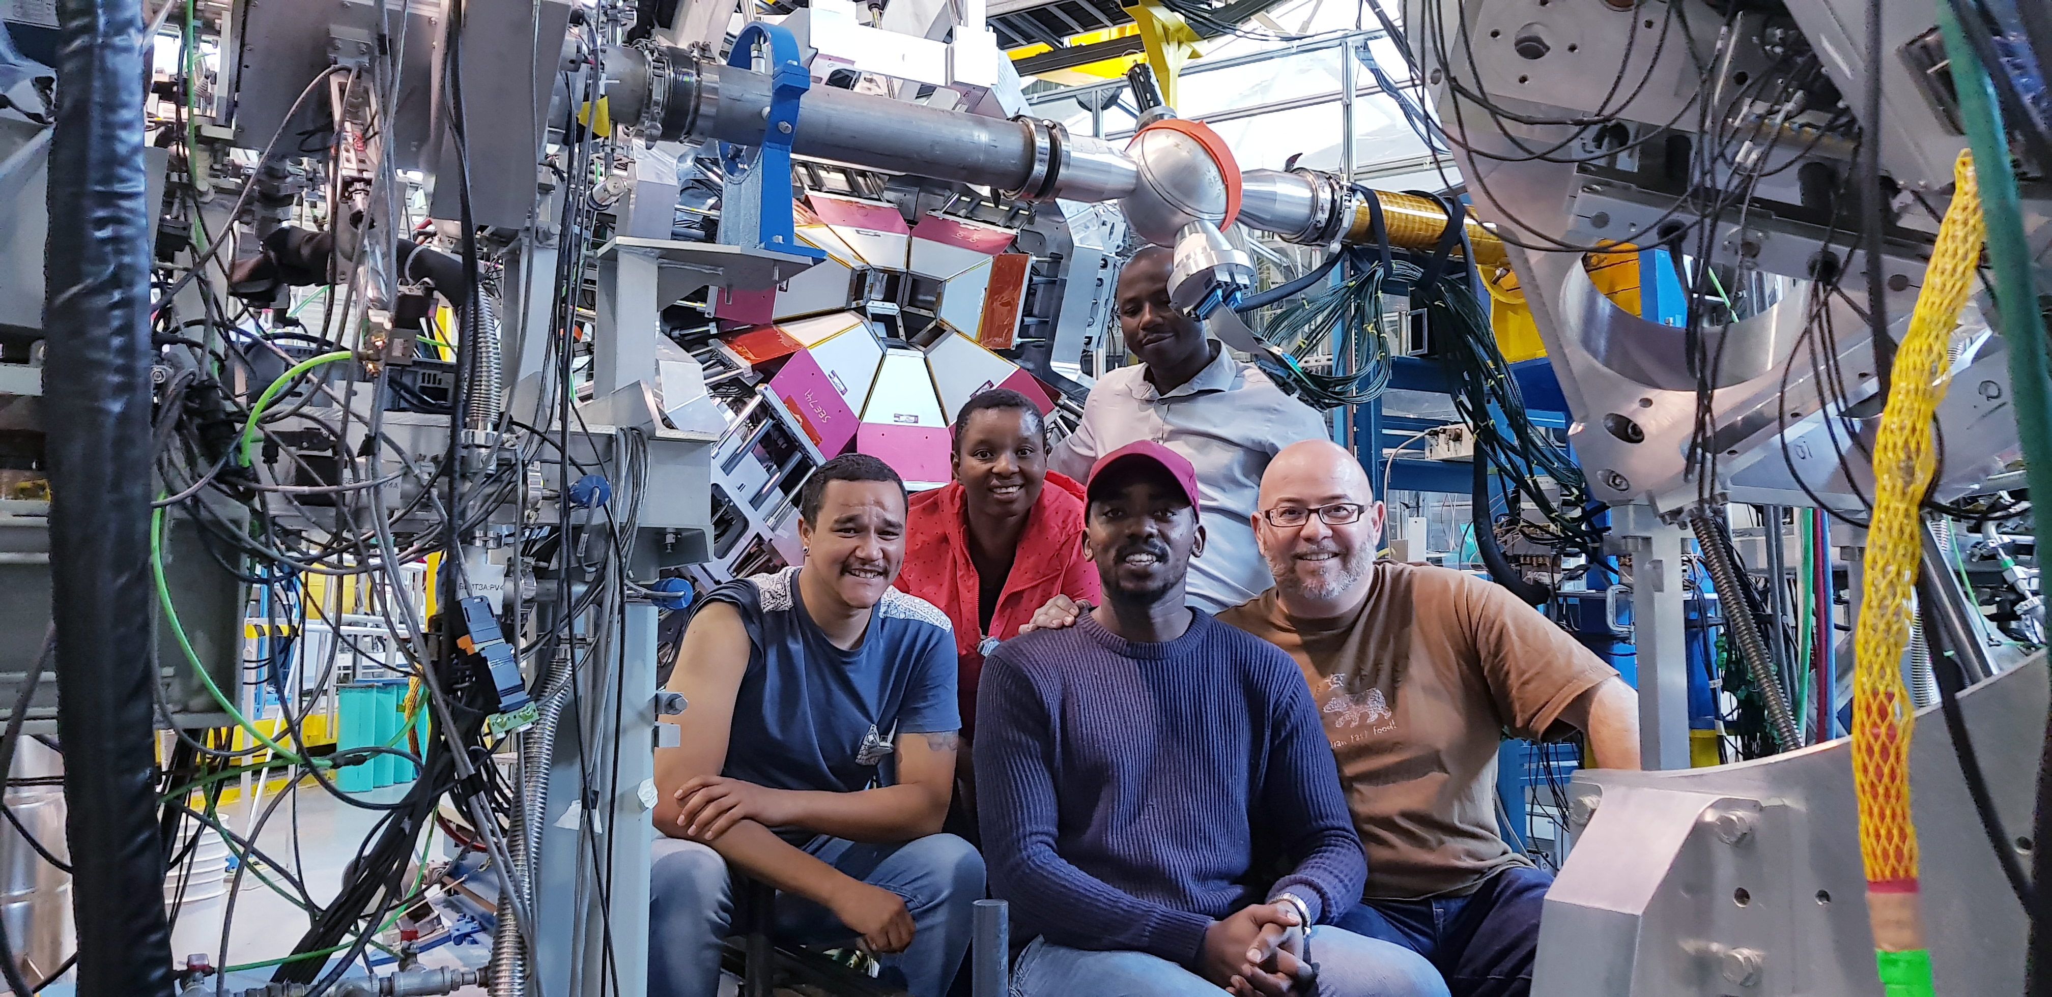
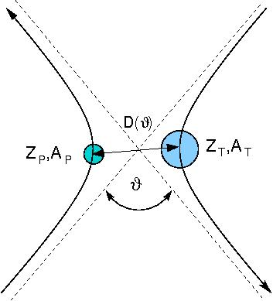
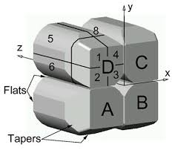
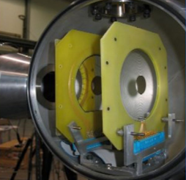
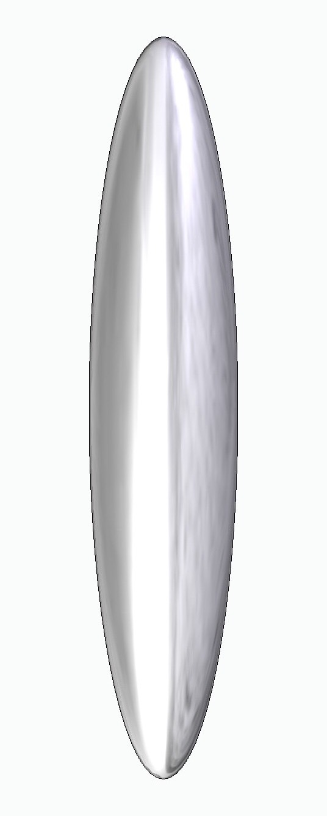
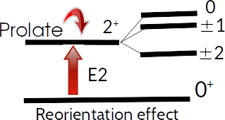
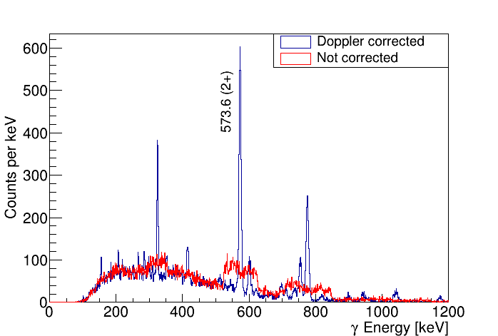
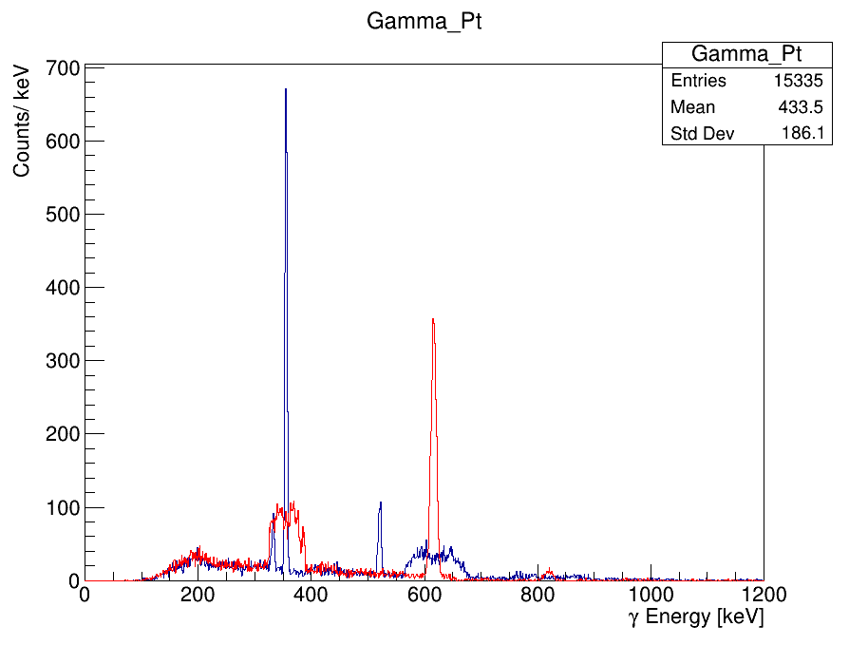
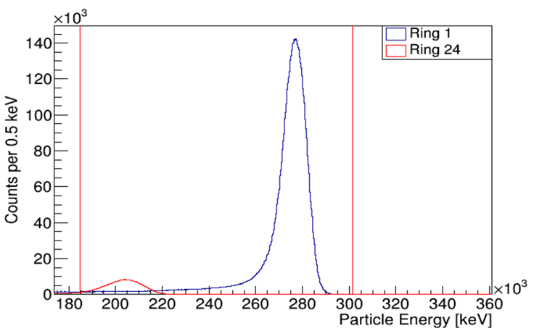
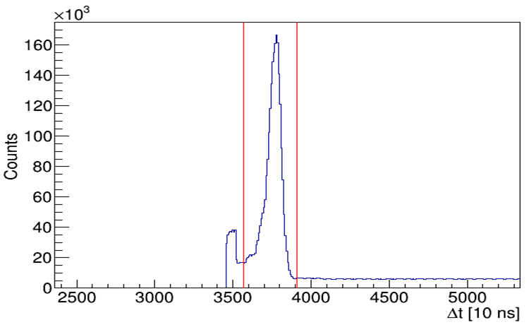


Study of Shape Coexistence in ⁸²Sr
S. Masango,^{1*} J.N. Orce,¹ N. Bernier,^{1,2,8} K. Abrahams,¹ F.A. Ali,^{3,4} L. Atar,³ G. C. Ball,² S. Bhattcharjee,² R. Caballero-Folch,² A. Chester, ²R. Coleman,³ T. Drake,¹¹ E. Dunling,^{2,11} S.A. Gillespie,² B. Greaves,³ G.F. Grinyer,⁵ J. Henderson,² E. Kasanda,³ R. Lafleur,^{2,3} D. Muecher,³ C. Ngwetsheni,¹ S. Ntshangase,¹² B. Olaizola,² T. Rockman,³ Y. Saito,^{2,8} L. Sexton,^{2,6} P. Siuryte,^{2,6} J. Smallcombe,² J.K. Smith,² C. Svensson,³ E. Timakova,^{2,7} J. Williams,⁹ T. Zidar³
¹ University of the Western Cape, ² TRIUMF, ³ University of Guelph, ⁴ University of Sulaimai, ⁵ University of Regina, ⁶ University of Surrey, ⁷ McMaster University, ⁸ University of British Columbia, ⁹ Simon Fraser University, ¹⁰ University of Toronto, ¹¹ University of York, ¹² University of Zululand
Abstract
Importance of Neutron-deficient ⁸²Sr Isotopes
The nucleus ⁸²Sr lies in a transitional region of the nuclear landscape, between the spherical nuclei about N = 50 and highly-deformed isotopes in the N≤40 region. The ratio of B(E2; 4⁺ →2⁺) ⁄ B(E2; 2⁺ →0⁺) deviates heavily from systematics at ⁸²Sr, which could indicate additional physics at relatively low excitation energy. Shape effects in ⁸²Sr have been investigated through safe multi-step Coulomb excitation using the TIGRESS array at TRIUMF, with the intention of measuring the B(E2) and Q_{S} values, in particular Qs(2⁺₁ ) and Qs(4₁⁺). The model-independent Kumar-Cline sum rules will be used to establish deformation and quantification of any axial asymmetry, allowing for the identification of phenomena such as shape coexistence. The extraction of transitional and diagonal matrix elements using GOSIA will probe the possibilities of shape coexistence and triaxial shapes. This is part of our systematics studies, which include Coulex measurements HIE-ISOLDE, to study neutron-deficient nuclei in the A~70-80 region.
Systematics of low-lying states:
There is no transition probabilities known for the 2⁺₃ or 0⁺₂ states, therefore they are excluded from rate calculations. They are populated in Coulomb excitation reactions.
Fig 1: Steady reduction in excitation energies and a corresponding increase in reduced transition probabilities. This matches well with the behaviour expected as one moves from near-spherical to highly-deformed nuclei [left];
Excitation energy and transition matrix element ratios are found to increase towards the axial rotor limit for more deformed neutron-rich nuclei. A significant deviation from the B(E2; 4⁺ → 2⁺) ⁄ B(E2; 2⁺ →0⁺) trend is found for ⁸²Sr. The behaviours expected for simple vibrational and rotational descriptions are indicated by the dashed lines [right].
Fig 2: Low-lying levels of interest in ⁸²Sr. Arrow thicknesses correspond to relative transition intensities. [Ref: NNDC]
Experimental Facility and Techniques
Coulomb-Excitation: Powerful tool to probe nuclear collectivity (rotations, vibrations, octupole, gamma bands, shape coexistence, etc.)
The nucleus is excited via first-order or single-step process, and the final states involving the magnetic substates of the 2⁺ state are populated via reorientation effect.
A beam of 3.4x10⁵ pps was impinged on a 2-mg/cm² ²⁰⁸Pb target at the safe Coulex limit of 4.28 MeV/u and on a 2-mg/cm² ¹⁹⁶Pt target at 4.17 MeV/u.
The particle detection was accomplished by the BAMBINO S3 detectors, providing coverage between 30° → 49.4° and 130.6° → 160°.
Fig 3: Sketch of the classical hyperbolic trajectory of the projectile following Rutherford scattering in the collision with the still target.
Fig 4: Schematic representation of the reorientation effect, a second-order effect in Coulomb-excitation perturbation theory. It shows the energy splitting of the magnetic substates of a J = 2+ state in a prolate even-even nucleus.
Fig 5: The TIGRESS array composed of 12 high-efficiency TIGRESS germanium clover detectors coupled to 2 double-sided S3 detectors.
Data Analysis and Results
Particle coincidence condition: The background subtraction in the particle and gamma-ray spectra was done by implementing coincidence conditions between the S3 rings and sectors. This condition allows the selection of detected particles with energies of interest in a chosen time window.
Fig 6: S3 particle spectra for rings 1 (innermost) and 24 (uppermost) [left] and S3-S3 time coincidence spectra [right] showing the coincidence gates [red vertical lines].
Fig 7: Doppler and non-Doppler corrected gamma-ray energy spectra for ⁸²Sr
using the ²⁰⁸Pb(⁸²Sr,⁸²Sr*)²⁰⁸Pb* Coulomb-excitation reaction at 4.28 MeV/u.
Conclusions and Outlook
Acknowledgements
Energy calibrations in progress for a better Doppler corrected peak
Detailed γ-spectroscopy of ⁸²Sr in progress
GOSIA calculations required to extract nuclear structure information (B(E2), Q_{s}, Q₀)
SA-CERN
Contact : email@email.com
Notes:
2023-09-27
1

